Slide 1
Applications of Greedy Method
Jyotiprasad patil
Harshit Goel

Slide 2
Contents-
Introduction
Minimum Cost Spanning Tree
Kruskal’s Algorithm
Prim’s Algorithm

Slide 3
Introduction
Among all the algorithmic approaches, the simplest and straightforward approach is the Greedy method.
Greedy algorithms build a solution part by part, choosing the next part in such a way, that it gives an immediate benefit.
Hence, we can say that Greedy algorithm is an algorithmic paradigm based on heuristic that follows local optimal choice at each step with the hope of finding global optimal solution.

Slide 4
Components of Greedy Algorithm
Greedy algorithms have the following five components −
A candidate set − A solution is created from this set.
A selection function − Used to choose the best candidate to be added to the solution.
A feasibility function − Used to determine whether a candidate can be used to contribute to the solution.
An objective function − Used to assign a value to a solution or a partial solution.
A solution function − Used to indicate whether a complete solution has been reached.

Slide 5
Minimum Cost Spanning Tree
What is a Spanning Tree?
Given an undirected and connected graph G=(V,E), a spanning tree of the graph G is a tree that spans G (that is, it includes every vertex of G) and is a subgraph of G (every edge in the tree belongs to G).
What is a Minimum Spanning Tree?
The cost of the spanning tree is the sum of the weights of all the edges in the tree. There can be many spanning trees. Minimum spanning tree is the spanning tree where the cost is minimum among all the spanning trees. There also can be many minimum spanning trees.

Slide 6
Kruskal’s Algorithm
The MST can be found using two algorithms
1) Kruskal’s Algorithm
2)Prim’s Algorithm
Kruskal’s Algorithm builds the spanning tree by adding edges one by one into a growing spanning tree. Kruskal's algorithm follows greedy approach as in each iteration it finds an edge which has least weight and add it to the growing spanning tree.
The time complexity Of Kruskal's Algorithm is: O(E log E).

Slide 7
Kruskal’s Algorithm Implementation-
Sort all the edges from low weight to high weight.
Take the edge with the lowest weight and use it to connect the vertices of the graph
If adding an edge creates a cycle, then reject that edge and go for the next least weight edge.
Keep adding edges until all the vertices are connected and a Minimum Spanning Tree (MST) is obtained.

Slide 8
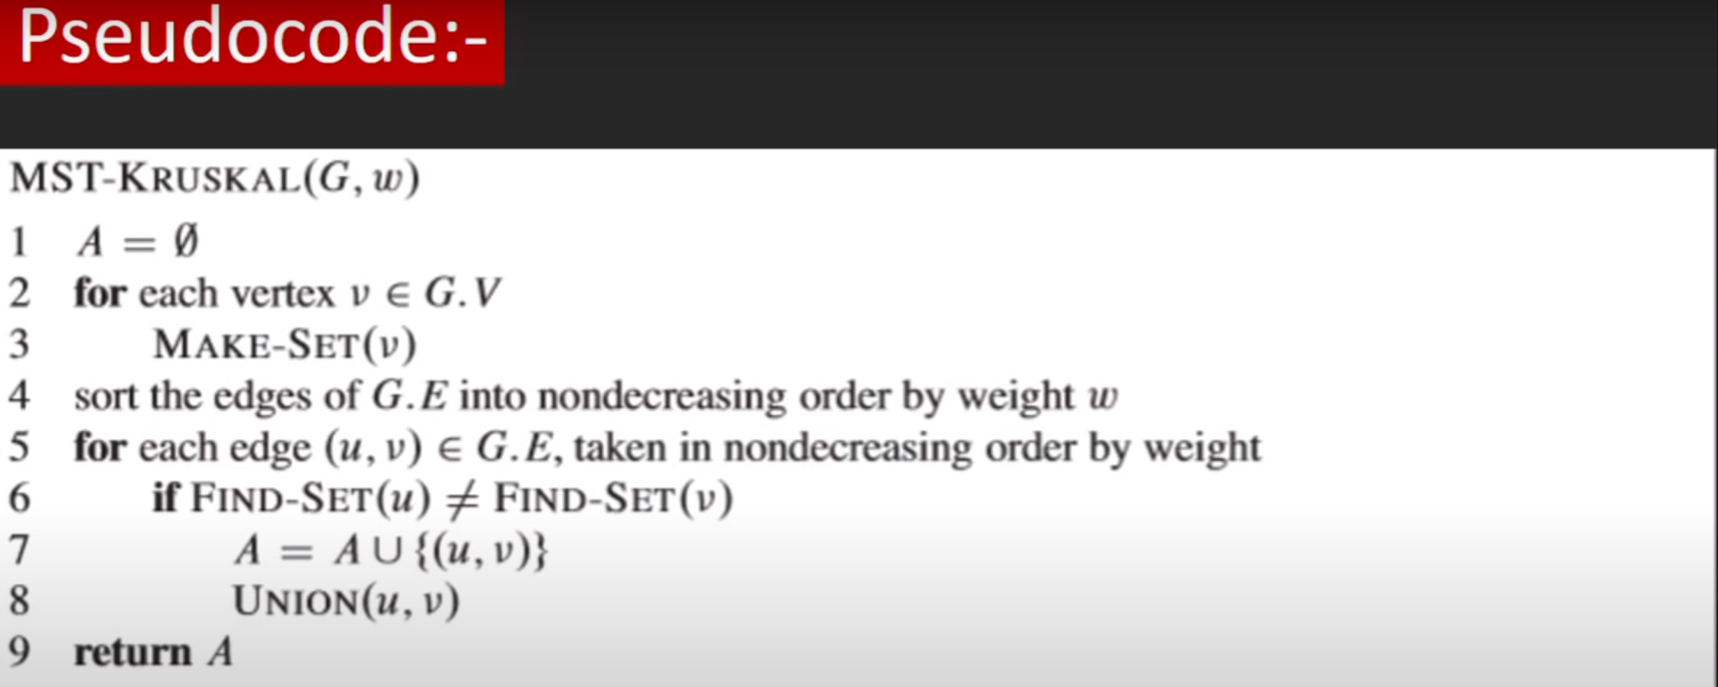
Pseudocode-

Slide 9
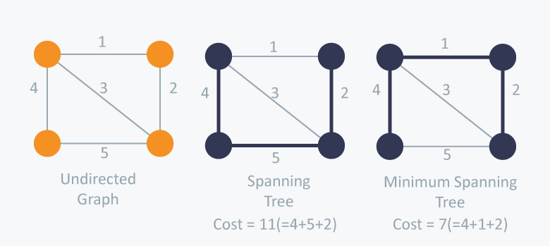
Example of MST using Kruskal’s Algorithm

Slide 10
Prim’s Algorithm
he time complexity of Prim's algorithm is O(E log V).
he time complexity of Prim's algorithm is O(E log V).
Prim's algorithm is a minimum spanning tree algorithm that takes a graph as input and finds the subset of the edges of that graph which
form a tree that includes every vertex.
has the minimum sum of weights among all the trees that can be formed from the graph.
The complexity of Prim’s Algorithm is O(ElogV)

Slide 11
Steps in performing Prim’s Algorithm
The steps for implementing Prim's algorithm are as follows:
1) Initialize the minimum spanning tree with a vertex chosen at random.
2) Find all the edges that connect the tree to new vertices, find the minimum and add it to the tree
3) Keep repeating step 2 until we get a minimum spanning tree

Slide 12
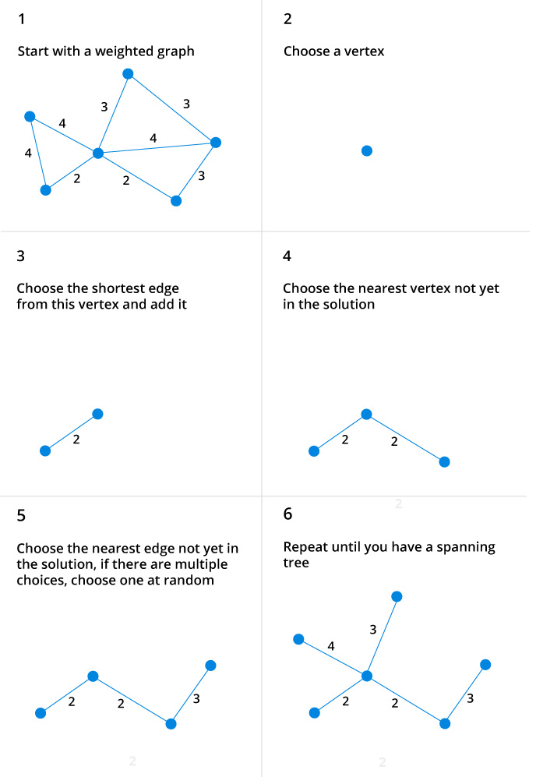
Prim’s Algorithm Example

Slide 13
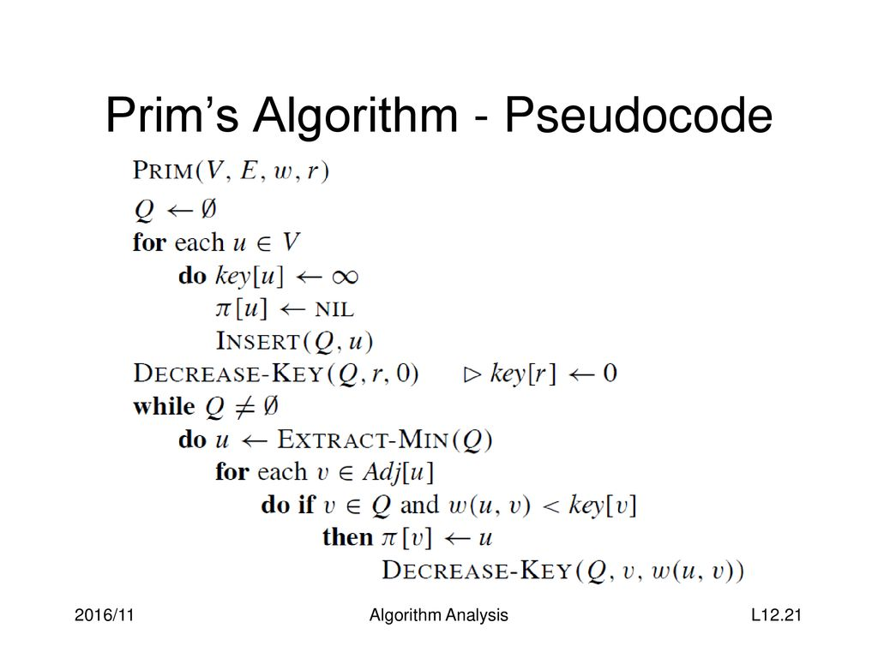
Pseudocode

Slide 14
Applications of Kruskal’s and Prim’s Algorithm
Minimum spanning trees have direct applications in the design of networks, including computer networks, telecommunications networks, transportation networks, water supply networks, and electrical grids. 2
Other Practical Applications-
Taxonomy.
Curvilinear feature extraction in computer vision.
Handwriting recognition of mathematical expressions.

Slide 15
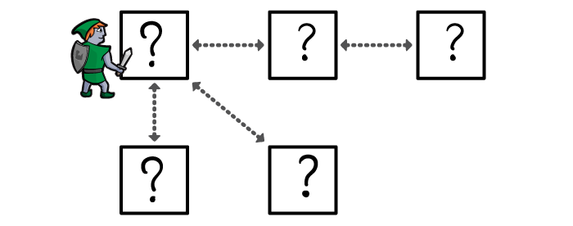
Dijkstra’s Algorithm

Slide 16
INTRODUCTION..
Dijkstra's Algorithm derived by a Dutch computer scientist ‘Edsger Wybe Dijkstra’ in 1956 and published in 1959.
It is a solution to the single-source shortest path problem in graph theory. Works on both directed and undirected graphs.Weighted graph G={E,V} and source vertex, such that all edge weights are nonnegative Output: Lengths of shortest paths (or the shortest paths themselves) from a given source vertex to all other vertices
It finds the shortest path from a given node a to all other nodes in the network . Node a is called a starting node or an initial node.
Also known as A* algorithm.

Slide 17
Numerical formulae
Formulae:-
o(|v|^{2+|}E|)=o(|v|²)
Where,
E = Edges ,V=Vertices.
|E|=Function of Edges.
|F|= Function of Vertices.
O= Constant.

Slide 18
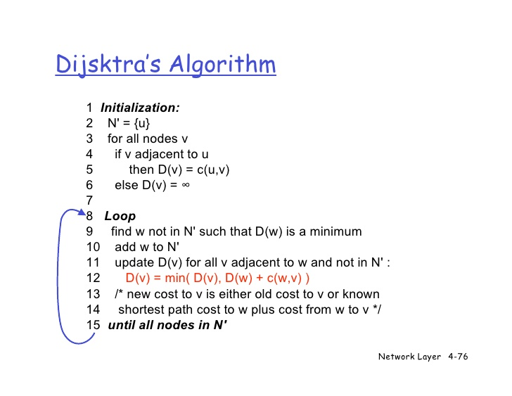

Slide 19
application of dijkstra’s algo…
In telephone networks.
Traffic Information system.
Mapping ( Google maps).
Routing systems.
In Robot Path Planning System.

Slide 20
In telephone networking..
In a telephone network the lines have bandwidth, BW. We want to route the phone call via the highest BW.
The bandwidth of a transmission line is the highest frequency that can be supported by the line.
Generally, the higher the frequency of the signal the more the signal is attenuated by the line.
If we are transmitted a digital signal then the BW represents the highest frequency or the fastest the signal can change from 0 to 0.
Bandwidth represents the amount of information that can transmitted by the line.
The vertices represents switching station, the edges represents the transmission line, and the weight of edges represents the BW.

Slide 21
Mapping ( google maps )
Dijkstra's Algorithm is known as the shortest path source
It is the backbone of every navigation system. Google Maps is a typical application of this Algorithm.
Google Maps is a cost-effective method to collect recent data comparable across the study area .
Google Maps uses Dijkstra's Algorithm of finding the shortest paths between nodes in a graph, which may represent, for example, road networks.
This takes into consideration on the ground realities and barriers such as rivers or mountain ranges to determine accessibility. .

Slide 22
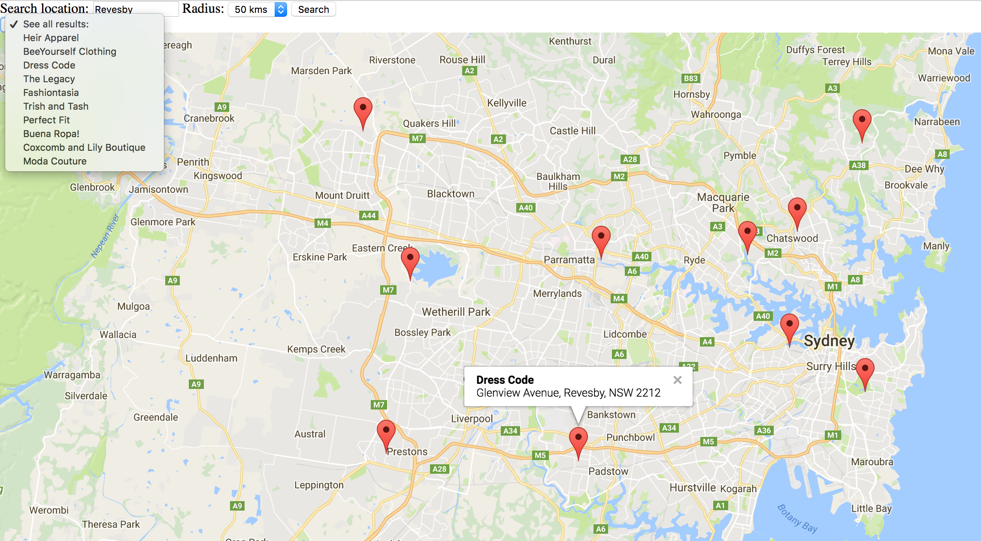

Slide 23
In robot path planning..
Path planning is a collision free path that the mobile robot could reach the goal state from the initial state.
The robot’s working space is two-dimensional structure of space.
Determining the current obstacles.
The intersection method is used to find the obstacles.
Draw a line l from source O to the goal G.
Determine whether there are intersections between the line l and the obstacles . If so, identify the obstacles that intersected with l first, connect the two endpoints as two vertices.
If l has no intersection with the obstacles, the robot will draw a straight line from the target point.

Slide 24
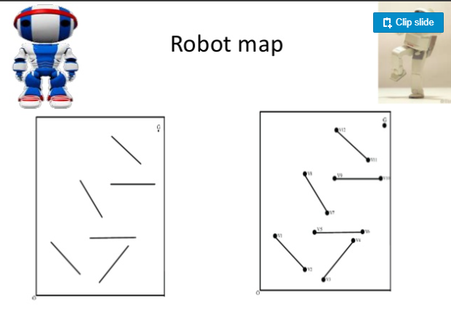

Slide 25
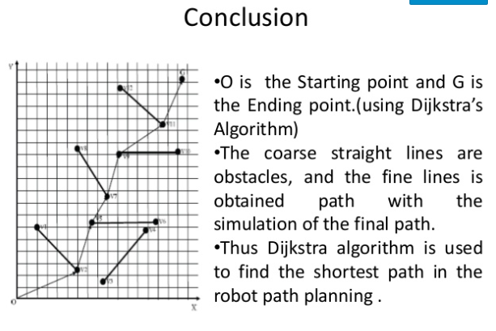

Slide 26
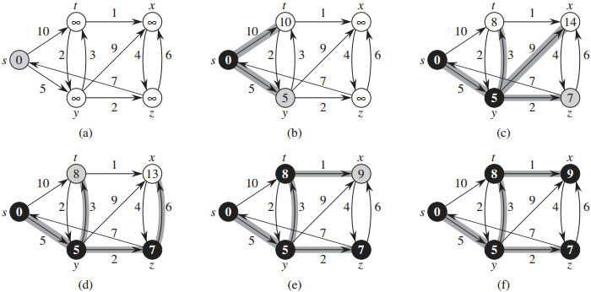
Here is small explanation on how to solve dikjkstra algo…

Slide 27


